Slide 1
Introduction to C++ and differences between C and C++
BY PRAPHUL KOLTE

Slide 2
Introduction
History of C Language
  Developed by Mr. Dennis MacAlistair Ritchie ( American Computer Scientist)
  Development years: 1969-1972
  Standards- C89, C90, C99, C11 etc
History of CPP Language
  Developed by Mr. Bjarne Stroustrup (Danish computer scientist)
  Standards- C++98, C++03, C++11, C++14,C++17 etc

Slide 3
Introduction
C++ is derived from C Language. It is a Superset of C.
Earlier C++ was known as C with classes.
In C++, the major change was the addition of classes and a mechanism for inheriting class objects into other classes.
Most C Programs can be compiled in C++ compiler.
C++ expressions are the same as C expressions.
All C operators are valid in C++.

Slide 4
Hello World in C++
#include<iostream>
using namespace std;
int main()
{
cout<<"Hello World";
return 0;
}
Compilation:
on Linux Platform
g++ Hello.cpp
After compilation it
will produce a.out file
Execution: ./a.out
cout is object of ostream
cin is object of istream
>> called as extraction or input operator
<< is called as insertion operator or output operator
Using namespace std is used to specify namespace
returning 0 tell OS that program execution is graceful

Slide 5

Compilation process
Compiler checks for syntax error
Source Code
Hello.cpp
Object Code
Hello.o
Library files.lib
(def of predefined functions)
Linker
Hello.o + .lib
Replaces preprocessor directives
a.out
Present on HD
Loading
RAM

Slide 6
Preprocessor
Preprocessor executes before compilation
Preprocessor directive starts with #
It is mainly used for
  File inclusion
  #include “filename”, #include<filename>
  Macro substitution
    #define PI 3.14
  Conditional compilation
    #define DEBUG
    #ifdef DEBUG
    //Any code
    #endif
#ifndef DEBUG
//Any code
#endif

Slide 7
Compiler
Compiler translates source code from a high-level programming language to a lower level language (e.g., assembly language, object code, or machine code) to create an executable program
Compiler does following tasks
  Scanning:
    Reads one character at a time from the source code
    Keeps track of which character is present in which line.
  Lexical Analysis:
    The compiler converts the sequence of characters that appear in the source code into a series of strings of characters (known as tokens)
    Tokens are associated by a specific rule by a program called a Lexical Analyzer.
    A symbol table is used by the Lexical Analyzer to store the words in the source code that correspond to the token generated.

Slide 8
Compiler
  Syntactic Analysis:
    Syntax analysis involves preprocessing to determine whether the tokens created during lexical analysis are in proper order as per their usage.
    The correct order of a set of keywords, which can yield a desired result, is called syntax. The compiler has to check the source code to ensure syntactic accuracy.
  Semantic Analysis:
    The structure of tokens is checked, along with their order with respect to the grammar in a given language.
    The meaning of the token structure is interpreted by the parser and analyser to finally generate an intermediate code, called object code.
    Finally, the entire code is parsed and interpreted to check if any optimizations are possible. If Possible optimization will be done

Slide 9
GCC: GNU Compiler Collection
GCC used for C, C++, Java etc.
GCC was first developed for GNU Operating System
Latest available version of GCC is 9.2
Examples:
Up to gcc6.1 Default cpp version in C++98
gcc6.1 has C++14 as default version
In gcc4.1 support for C++11 added
Language | Sample Command
C | gcc Hello.c
Cpp | g++ Hello.cpp
Java | gcj Hello.java

Slide 10
Linker
Linker is a computer utility program that takes one or more object files generated by a compiler and combines them into a single executable file, library file, or another 'object' file.
Types of Linking
  Static Linking (compile time)
  Ex *.lib
  Dynamic Linking ( run time)
    Ex. *.dll

Slide 11
Program memory
When we run a program ,os allocates part of memory for that program and then copies executable from disk to memory.
The C compiler divides this area in 4 parts
  Stack
  Heap
  Code Area/Segment
  Data Area/Segment
    Initialized data
    Uninitialized data

Slide 12

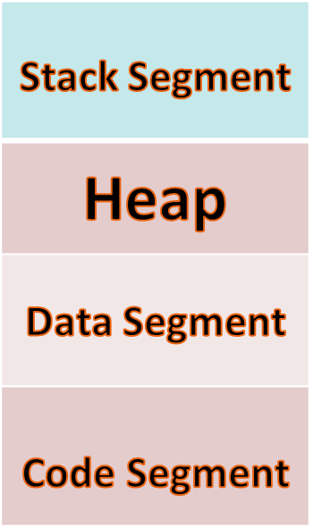
Program Memory
Keeps Function Activation Record /Stack frame
String manipulation and dynamic memory allocation
Memory for global and static variables
All machine level instructions

Slide 13
Code Segment
Fixed in nature because size of program is known at load time.
It is reserved for executable code of program.
This is read only memory area we can not change it during execution.
Only Pointers to functions can access this area.

Slide 14
Data Segment
Fixed in nature because size of programs data is known at load time.
It contains internal and external static variables, global variables, initialized array and structures and constant strings.
Initialized Data Area:
    On Initialization static and global variables are stored at initialized data area. All other variables gets stored in uninitialized data area.
Uninitialized Data Area:
    In uninitialized data area variables get initialized to 0 nut in initialized area they are initialized with their respective values.
    Static and global variables known as load time variables.

Slide 15
Keywords from C to C++
auto const double float int short struct unsigned break continue else for long signed switch void case default enum goto register sizeof typedef volatile char do extern if return static union while

Slide 16
Keywords in C++
30 reserved words that were not in C:
asm public private protected new delete bool false true try catch throw class this friend template using namespace inline typename typeid wchar_t explicit virtual mutable operator static_cast dynamic_cast reinterpret_cast const_cast

Slide 17
Predefined identifiers
cin endl INT_MIN iomanip main npos std cout include INT_MAX iostream MAX_RAND NULL string

Slide 18
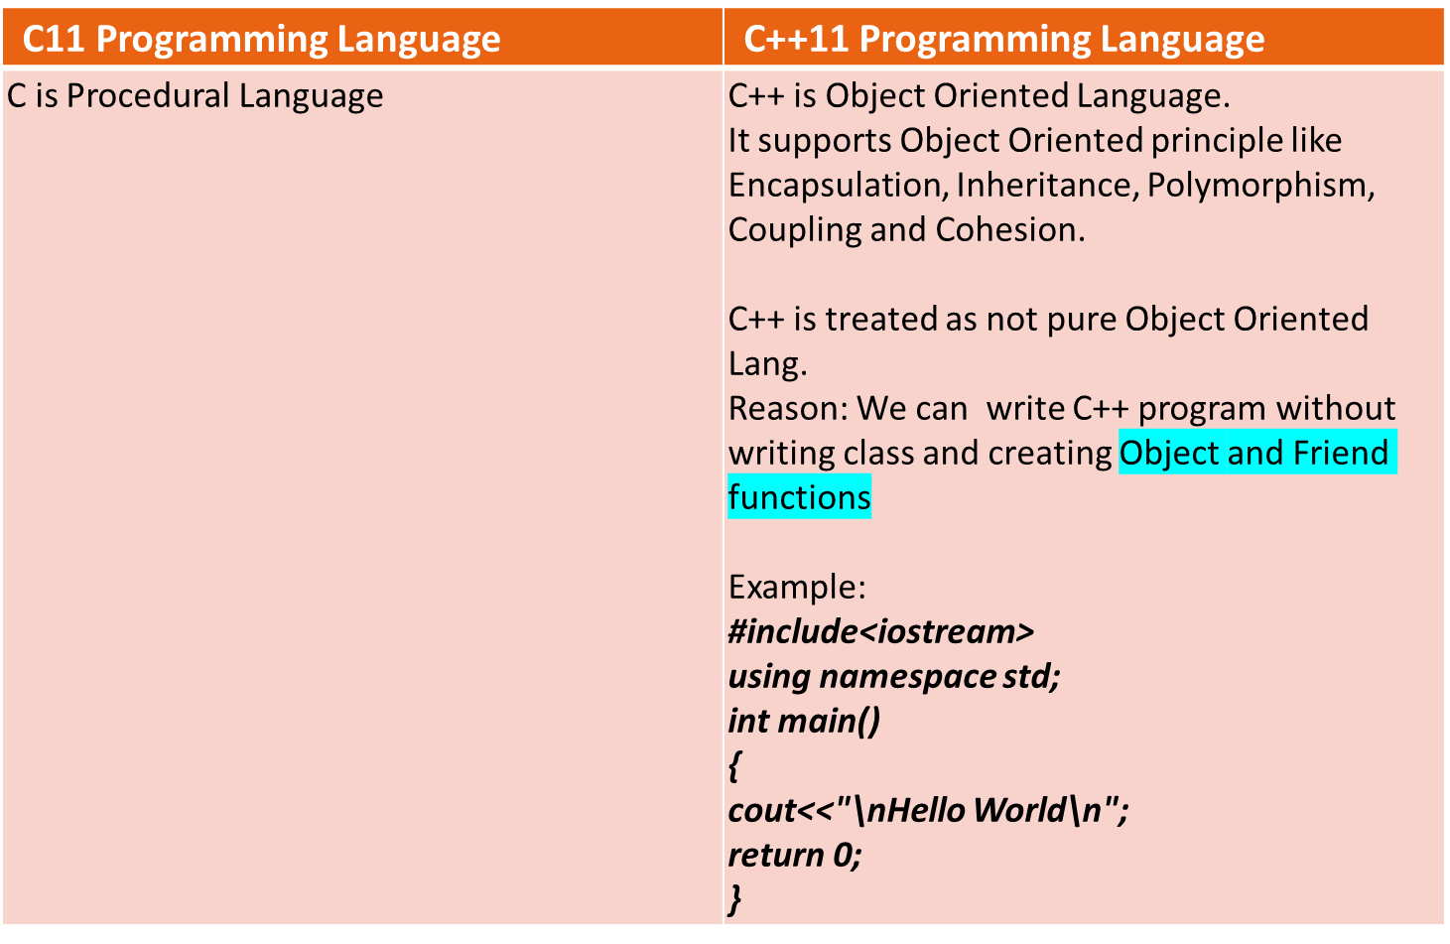
Difference between C and C++

Slide 19
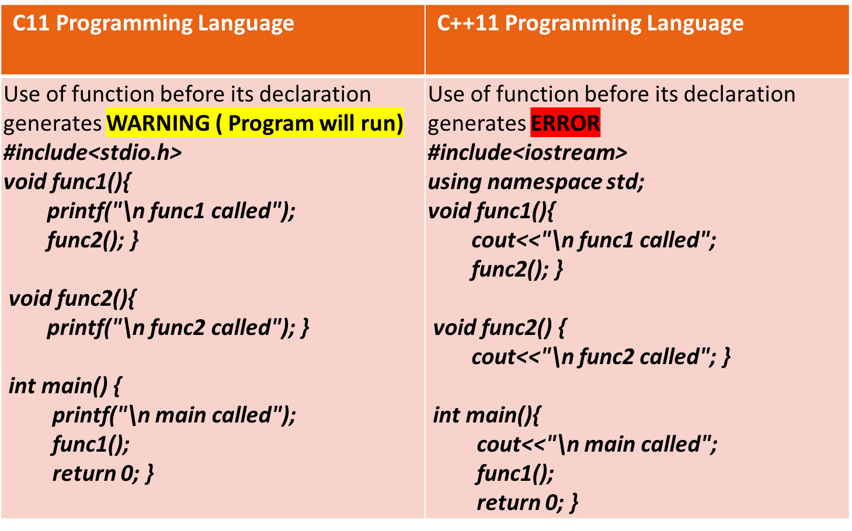
Difference between C and C++

Slide 20
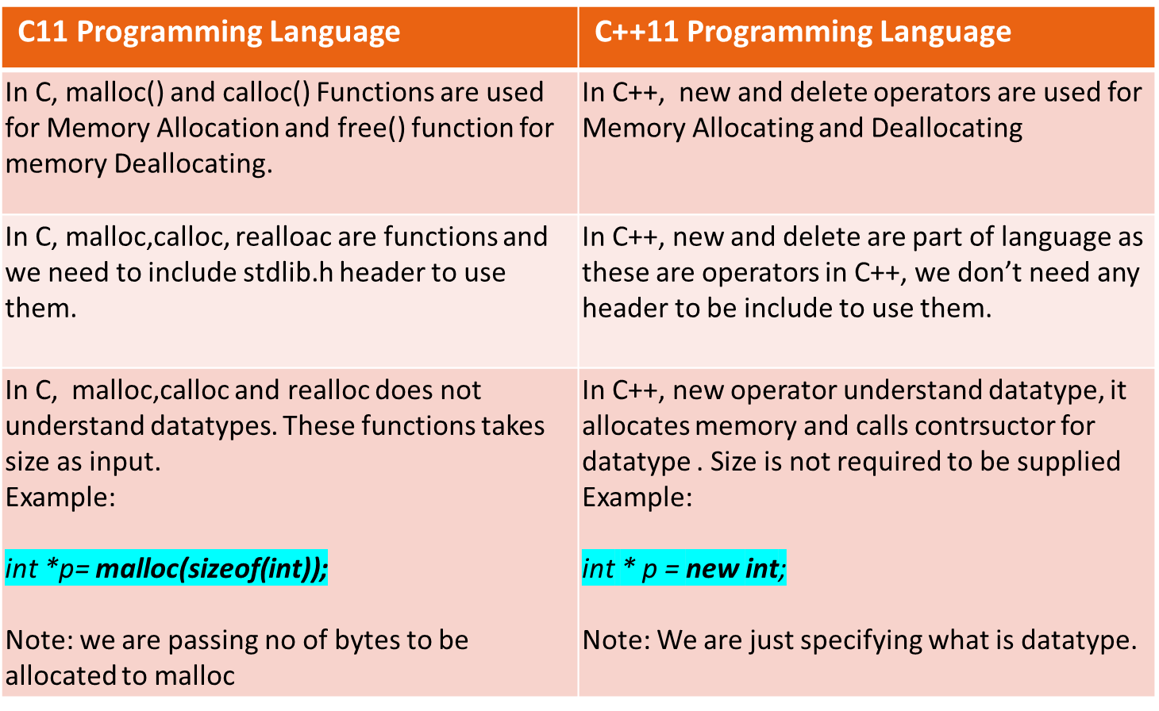
Difference between C and C++

Slide 21
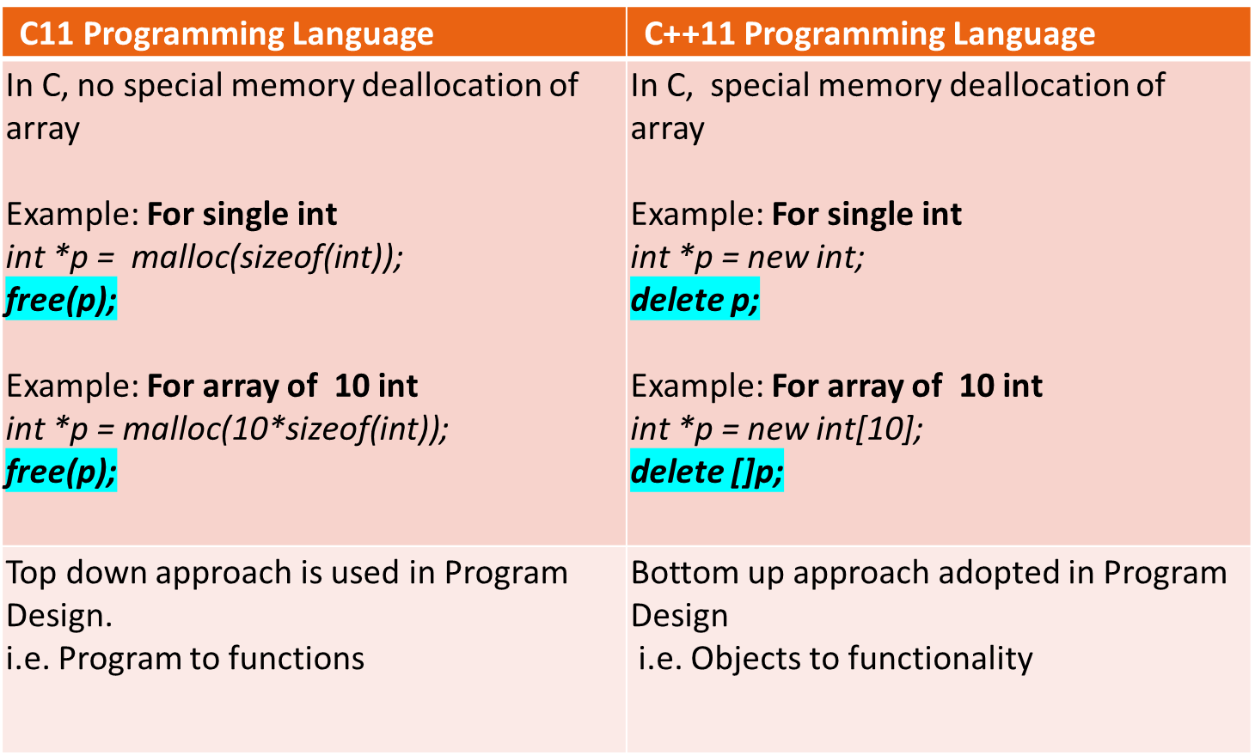
Difference between C and C++

Slide 22
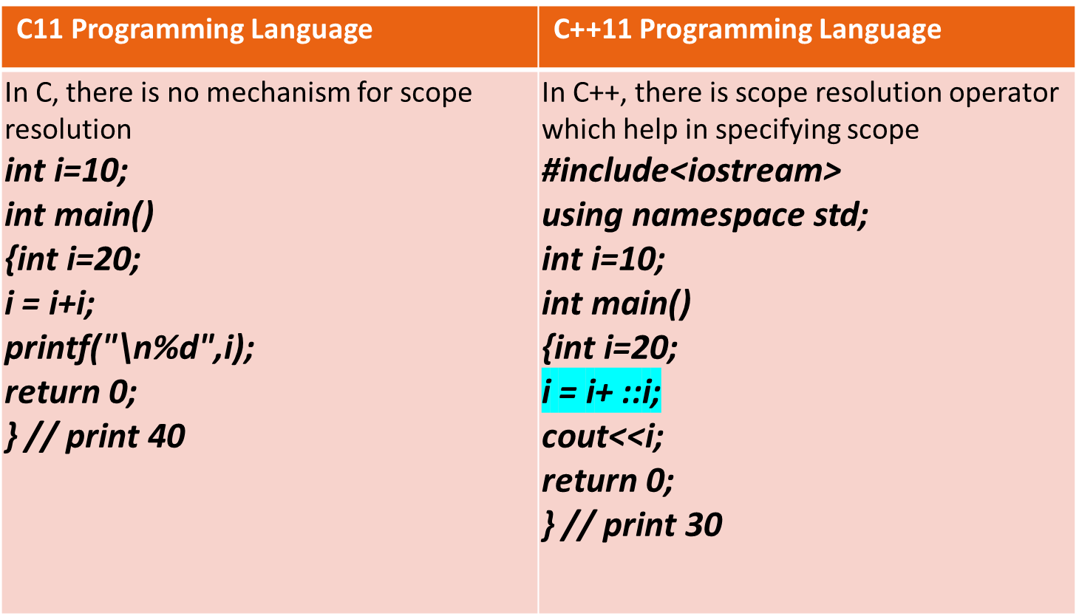
Difference between C and C++

Slide 23
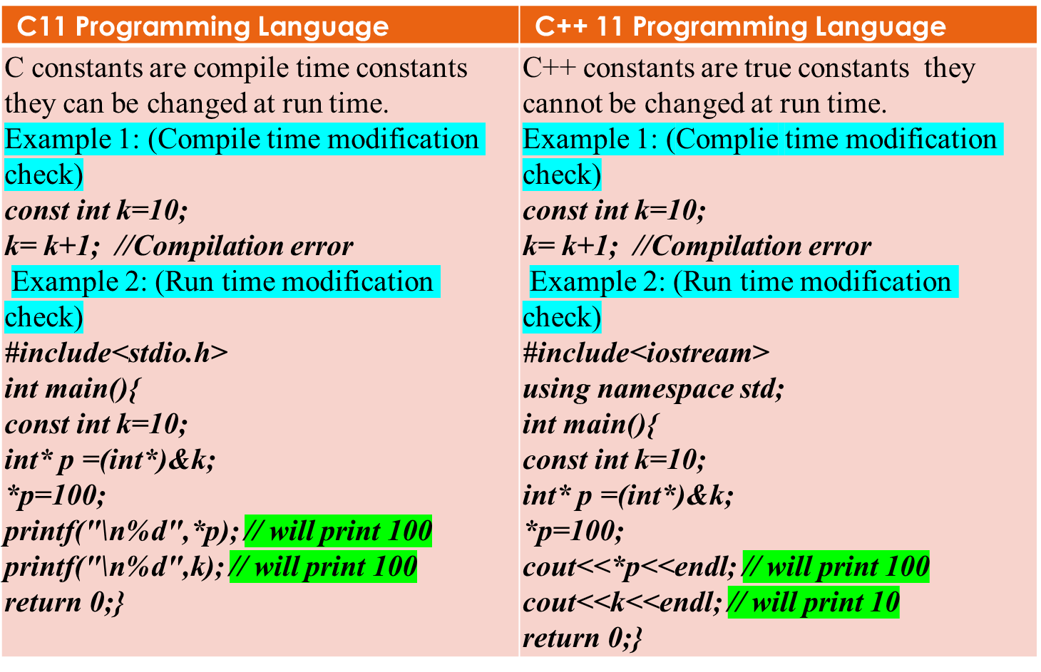
Difference between C and C++

Slide 24
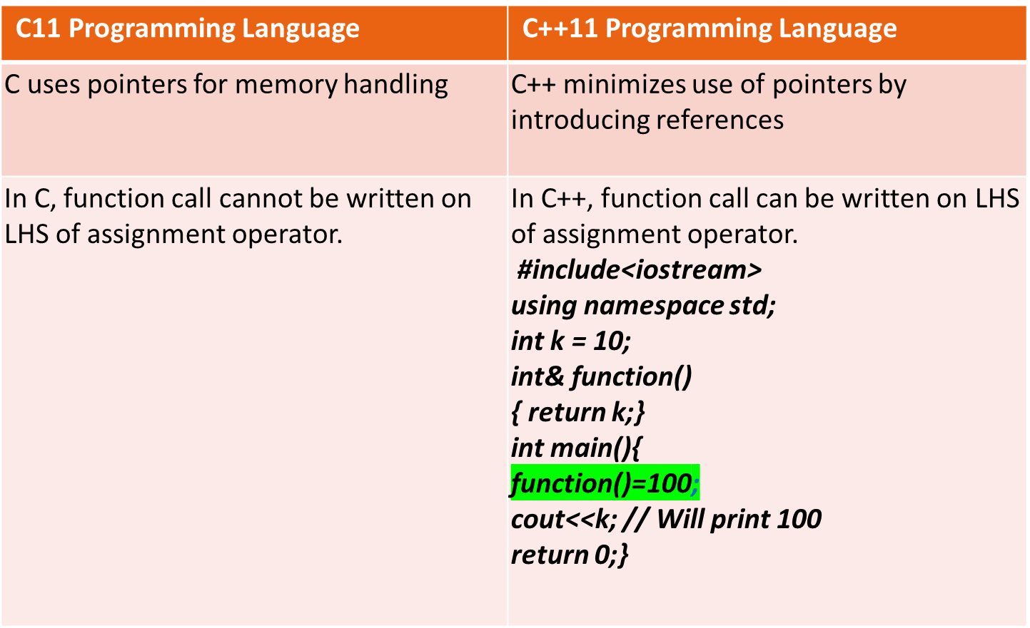
Difference between C and C++

Slide 25
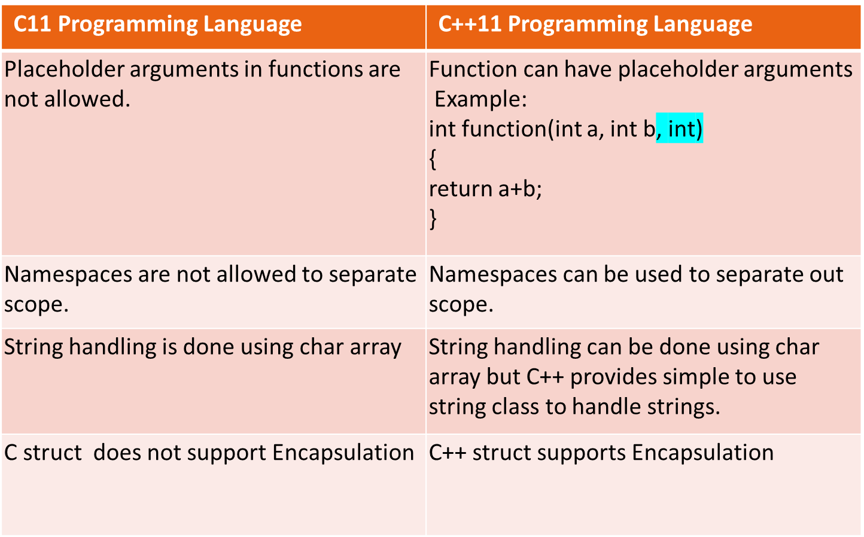
Difference between C and C++

Slide 26
The C++ string class
Must #include <string> to create and use string objects
Can define string variables in programs
string name;
Can assign values to string variables with the assignment operator
  name = “Alia";
Can display them with cout
  cout << name;
Can input string with cin
  cin >>name;

Slide 27
Thank You
Feel the difference!!!! ……….C++

